Slide 1
CROSS-CONNECTION CONTROL
2017 ANNUAL SUMMARY REPORT
Washington State Department of Health
Office of Drinking Water

Slide 2

Website Training
April 17, 2018
Nathan Ikehara
Engineer in Training
Engineering and Technical Services
Notes:
At the Office of Drinking Water our presentation slide standards have recently come to include a picture…so now you know what I look like.
My name is Nathan Ikehara, and since mind-2015 I’ve been working in the Office of Drinking Water. In that time, I’ve had the chance to discuss the principles of data integrity with many systems on a one-on-one basis, but this marks the first time I’ve been able to present it in a group setting.
As we begin, for those of you taking notes, I’d like you to write this down: “How do I know the data I collect, use, and report are accurate?” - repeat
Notice I didn’t say “think” or “feel”. “Know”. It’s the question that has driven this project and it’s be the question I’m hoping to address today. Let’s get started.

Slide 3
DOH CCC Program News
CCC Program in a holding pattern
  Supports updates of existing DOH CCC Manual and development of new manuals
  Retains the major elements of the current CCC Program—Technical assistance, ASR data collection and compliance
  No expansion planned through 2019
Steve Deem—Distribution System Engineer
Bill Bernier—New position
Notes:
Let’s start with the “why”. As I mentioned, we’re going to be focusing on free chlorine in this discussion (1960 disinfectors).
There are three general reasons that chlorine gets added to water:
Protection of the distribution system:
246-290-451(5) If the department determines that any of the following conditions apply, the purveyor shall provide continuous disinfection of the distribution system and meet the requirements under subsection (7) of this section:
(a) E. coli MCL violations;
(b) Level 1 or level 2 assessment treatment technique triggers;
(c) Failure to complete level 1 or level 2 assessments as required under WAC 246-290-320 (2)(b);
(d) Failure to complete corrective actions required under WAC 246-290-320 (2)(d); or
(e) Facility failures that threaten to degrade water quality in the distribution system.
"Detectable residual disinfectant concentration" means 0.2 mg/L free chlorine, total chlorine, combined chlorine, or chlorine dioxide.
246-290-451(7) A purveyor that adds free chlorine, total chlorine, combined chlorine, or chlorine dioxide to the distribution system on a continuous basis shall:
(a) Monitor residual disinfectant concentration at:
(i) Representative points in the distribution system at least once per day, five days per week, unless upon written request, the department approves less frequent monitoring; and
(ii) The same time and location of routine and repeat coliform sample collection.
(b) Maintain a detectable residual disinfectant concentration in all active parts of the distribution system, unless the department approves a written request to use a lower value. At a minimum, the request to use a lower value must identify the instrument used to measure the residual disinfectant concentration and include the manufacturer's documentation of the instrument's accuracy to measure the lower value.
When a source is potentially contaminated, there must be continuous disinfection of the source prior completed prior to or at the first customer 246-290-451(4)
(a) A groundwater source is in hydraulic connection to surface water under WAC 246-290-640(4);
(b) A history of unsatisfactory total coliform sampling results for a groundwater source;
(c) A microbial contaminant threat within a groundwater source sanitary control area as defined in WAC 246-290-135;
(d) A microbial contaminant threat to a source, as documented in a susceptibility assessment, a sanitary survey, or a special purpose investigation which also includes, but is not limited to, one or more of the following conditions:
(i) A poorly constructed source;
(ii) An inadequate surface seal;
(iii) High groundwater;
(iv) Lack of confining layers in the aquifer;
(v) A shallow well source, with the first open interval fifty feet or less from the ground surface at the wellhead;
(vi) A drilled well in fractured bedrock; or
(vii) A source at risk of flooding.
(e) Desalination of a seawater water source by reverse osmosis.
There are two types CT6 and 4-Log (99.99% inactivation of viruses for GWI)
246-290-451(6) If disinfection is required under subsection (4) of this section, the following requirements must be met:
(a) Provide any combination of free chlorine residual concentration (C), measured in mg/L at or before the first customer and contact time (T), measured in minutes between the location of chlorine treatment and residual measurement, that result in a CT product (C x T) of greater than or equal to six without exceeding the chlorine MRDL in WAC 246-290-310(5).
(b) The department may require the purveyor to provide longer contact times, higher chlorine residuals, or additional treatment to protect the health of consumers served by the water system.
(c) To demonstrate the required level of treatment is maintained, the purveyor shall:
(i) Monitor the residual disinfectant concentration at the point of entry to the distribution system, or at a department-approved location, at least once per day, five days per week or each day that water is supplied by the treatment plant if it operates less than daily;
(ii) Identify the number of days each month that the treatment process failed to meet the disinfection treatment requirement in this subsection; and
(iii) Submit monthly water treatment reports to the department using a department-approved form by the tenth day of the following month.
(d) All analyses required in this subsection shall be conducted in accordance with an EPA approved method. A diethyl-p-phenylenediamine (DPD) colorimetric field test kit relying on a visual color comparison to a visual standard may not be used by a purveyor to comply with the requirements of this subsection.
(e) The department may require the purveyor to monitor the residual disinfectant concentration each calendar day water is supplied to the distribution system if the department considers source treatment operation unreliable.
(f) The department may require the use of continuous residual analyzers and recorders to assure adequate monitoring of residual concentrations.
Finally, sometimes chlorine is added to augment another process:
To oxidize iron, manganese and hydrogen sulfide to facilitate their removal,
to reduce color in water, and
to aid in such treatment processes as sedimentation and filtration. https://www.purewaterproducts.com/articles/types-of-chlorine-used-in-water-treatment
Each of these disinfection goals has a specific point of compliance
Distribution System is from representative locations (not simply worst-case)
Source disinfection is prior or at the first customer
Part of the design approval for the treatment chlorine is augmenting

Slide 4
DOH CCC Program Plan Major Elements
Tech
Assistance
& Training
Comm.
Interagency Coordination
ASR Data
Collection
Sanitary Survey
& Planning
Programs
CCC
Compliance
CCC
Guidance
Development
Notes:
How much of this remains?

Slide 5
Annual Summary Report (ASR)
Background Information

Slide 6
DOH CCC Data Collection
For 2017 reporting year, DOH’s continuing to target the largest community systems in Washington (1,000 or more connections)
These public water systems
  Serve over five million people, the majority of our state’s population
  Are most likely to serve severe and high-hazard premises (Table 9)
First collected data in 2002 (for 2001)

Slide 7
Purpose of CCC Reporting
Gather statewide and system-specific CCC data
Determine status of
  Written CCC Program Plans
  CCC Program implementation
Assess backflow prevention at severe and high-hazard facilities

Slide 8
Annual Summary Report Data Uses
Basis for CCC compliance
Identify CCC Program deficiencies
Identify guidance and training needs
Show CCC/public health improvement trends
Establish CCC Program direction
Respond to questions from purveyors, legislators, customers and others

Slide 9
Annual Summary Report (ASR)
Applicable Regulatory Requirements

Slide 10
Cross-Connection Control Specialist (CCS)
Located in Operator Certification Rule
  WAC 246-292-033(2)
CCS must develop and maintain purveyor’s CCC records
CCS must complete, sign, and make CCC reports available to DOH including ASRs

Slide 11
Public Water System (PWS) CCC Reporting
Located in Drinking Water Rules
  WAC 246-290-490(8)
PWS must complete CCC summary reports annually
PWS must submit reports to DOH upon request

Slide 12
Annual Summary Report (ASR)
Process and Schedule

Slide 13
General ASR Process
Identify ASR systems for reporting year
  Community systems with >1,000 total connections
  Past ASR systems that now serve <1,000 connections
  For 2017, 242 systems met criteria
Open new website and email “official” notices to ASR and WFI contacts
Provide technical assistance and training
CCC compliance

Slide 14
2018 ASR Schedule
Date | Task
February 5, 2018 | Launched new ASR website and emailed “official” ASR notification letter
March 15, 2018 | First completion reminder to system that haven’t submitted completed ASR
April 17, 2018 | Provide ASR Training Webinar/Workshop (Welcome!)
May 4, 2018 | 2017 ASR forms due (~90 days after launch)
June 2018 | Begin ASR-related compliance activities (reporting and premises isolation violations)

Slide 15
Annual Summary Report (ASR)
Submittal Requirements

Slide 16
ASR Submittal Requirements
All ASR systems must submit
  Annual Activities form (blue) and
  Program Summary form (cream)
In addition, systems
  Serving Severe Health Hazard
  Facilities must submit gray form
  Granting, renewing, or cancelling
  Exceptions must submit green forms
All ASR systems must use website to complete and submit forms to DOH

Slide 17
Blank 2017 ASR Forms Online
For ease of data entry, many PWSs print and
fill out blank forms before logging into website
Blank 2017 ASR forms posted to:
  Office of Drinking Water CCC webpage
  Help link in ASR website
ASR forms available in both Word (fillable forms) and pdf format

Slide 18
Annual Summary Report (ASR)
Website General Information

Slide 19
ASR Website—Overview
Import feature for 2017 data
Includes security features
Includes resources—Quick Reference Guide, Downloads Page
Contains data error checks within and between forms
Requires CCS to certify ASR forms to submit to DOH

Slide 20
Website Access Limited for Security
Access website by either
  Using link in communication email (directive letter)
  Typing address into Internet browser address field
Unique combination of PWS ID and DOH-assigned PIN for login
Recommend add ASR website to Internet browser “Favorites”

Slide 21
ASR Security Confirmation Emails
Reduced number of email triggers
Added summary data email
Don’t need to reply, but if it doesn’t show, check junk/spam email folder
PWS Action | Trigger Email to
Submit Contact Information | Designated CCS/CCC Program Manager only
ASR Forms Package Certified/Submitted | Both the Designated CCS/CCC Program Manager and ASR PWS Manager
ASR Forms Package Unsubmitted | Both the Designated CCS/CCC Program Manager and ASR PWS Manager

Slide 22
ASR Security Session Timer
Data entry sessions timeout after 30 minutes
  Minutes remaining show at top of each webpage
If session times out, you’ll lose unsaved data
Timer resets when
  Change pages
  Click Save
  Ready to Submit
  Any navigation buttons

Slide 23
Resources: Downloads Page
Blank 2017 ASR forms
Additional documents to help you properly complete ASR forms
Updated Medical Category Table, FAQs, webinar PowerPoint presentations, etc.
Five-page “ASR Help Guide” to help users with 2017 ASR website

Slide 24
Contact Information Screen
Must complete Navigation Screen Step 1: CCC Contact Information before other “Step” buttons become enabled
Must pass data error checks to
  Successfully Submit Contact Info
  Gain access to new ASR forms for 2016 (Step 2)
DOH needs your contact info
  To pre-populate specific fields on all ASR forms
  For confirmation and other CCC-related emails

Slide 25
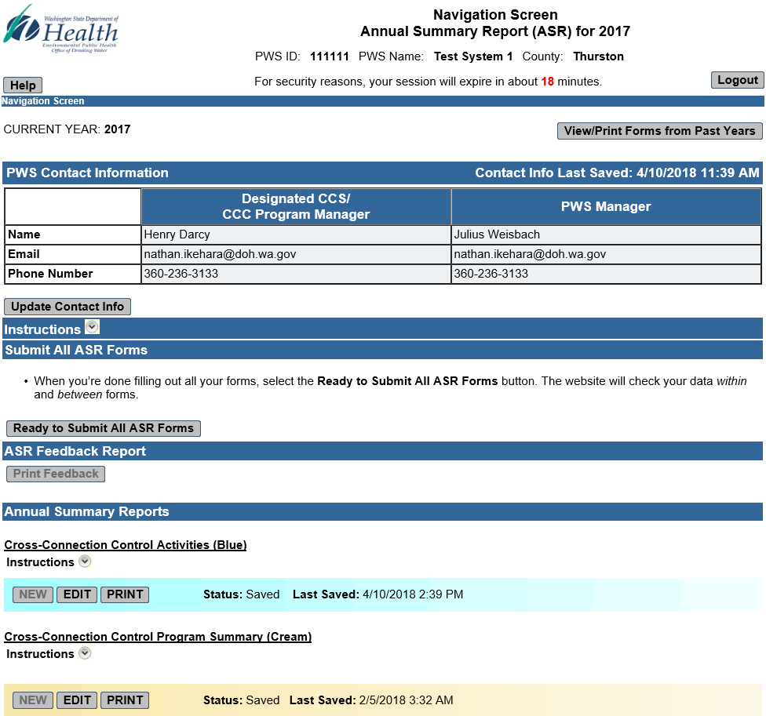
Navigation Screen
Navigation ASR forms
View/Print Forms from Past Years
View/Print Feedback

Slide 26
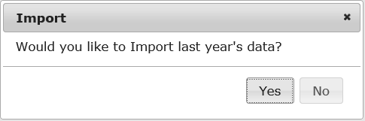
Import Feature Pop-Up
One-time option to import last year’s data onto this year’s forms
Import pop-up displays when click New button on blue, cream, or gray forms on Navigation Screen

Slide 27
Grayed Out Fields
Added to improve overall data quality
Reminder—you can’t enter data into grayed out fields!
Examples
  Totals the website calculates for you
  Other fields the website fills in for you
  Fields that block entry of illogical data based on your data in a related field

Slide 28
ASR Forms
Save vs. Ready to Submit Buttons
Click the Save button to save your ASR form as a draft (work in progress)
Once you’ve entered all data on an ASR form, click the Ready to Submit button (triggers data checks within the form)

Slide 29
Ready to Submit All ASR Forms
When you’ve completed your required ASR forms, click Ready to Submit All ASR Forms button on Navigation Screen
  Website will check your data for errors within and between forms
  If the Data Errors Screen displays, resolve errors
Repeat process until ASR Forms Package Certification and Submission Screen displays

Slide 30
ASR Forms Package
Certification/Submission Screen
Designated CCS must certify ASR Forms Package
Type name in certification statement box and complete both checkboxes (all required fields)
Click Submit ASR Forms Package button
Forms Package Submission Confirmation Screen will display with Congratulations message
Save or print final forms for PWS records

Slide 31
ASR Form Comments Important
Office of Drinking Water staff have access to all your system’s ASR forms (current and past)
We strongly encourage you to provide
comments on each ASR form

Slide 32
ASR Form Comments Important (Continued)
Include information such as
  Explanations for data on forms
  CCC personnel changes
  Changes in CCC Program status
  Accomplishments for current reporting year
  Goals/priorities for the next reporting year

Slide 33
Annual Summary Report (ASR)
Website Live Demonstration

Slide 34
ASR Website—Live Demonstration
Access Website, Login, and
Contact Screen

Slide 35
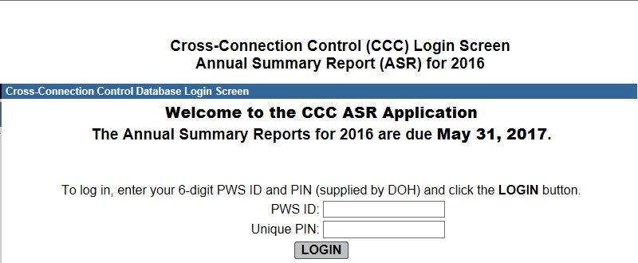
Access ASR Website and Login
Access ASR website Login screen at: https://fortress.wa.gov/doh/ccc/
Enter 6-digit PWS ID and DOH-assigned PIN and click LOGIN button

Slide 36
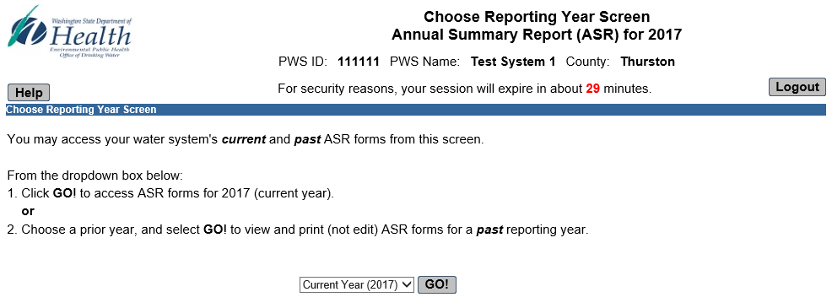
Choose Reporting Year
Click GO for current year (2017) to get to Navigation Screen
View past ASR forms by selecting a prior reporting year from the dropdown

Slide 37
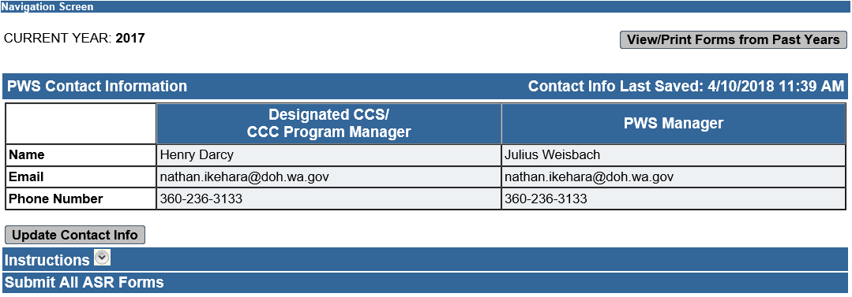
Navigation Screen - Step 1
Click Step 1: PWS Contact Info button to get to the Contact Information Screen

Slide 38
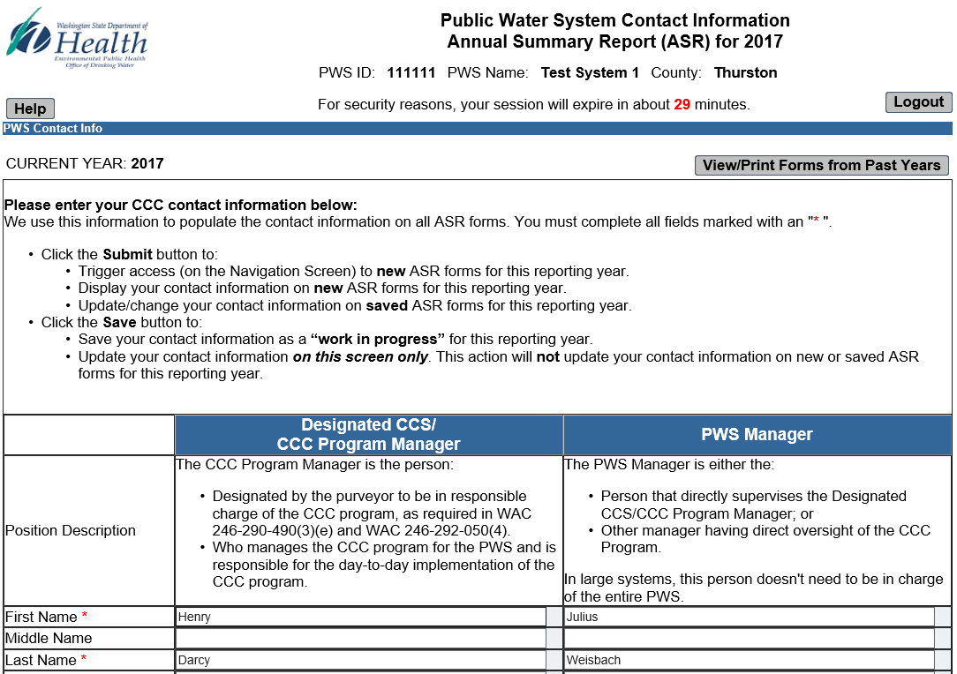
Complete PWS Contact Information

Slide 39
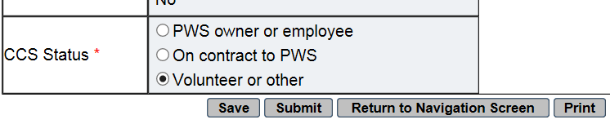
Contact Info Screen Notes—1
Use Save to save your info as a draft (or to update the info on this screen only)
Use Submit when you’ve completed all required fields on Contact Info Screen
Note—Submit triggers the data errors check

Slide 40

Contact Screen Notes—2
To successfully Submit contact info, you must:
  Complete all required fields
  Provide phone numbers in valid format
  Provide matching emails in valid format
If you pass the data error checks on Submit, the Navigation Screen will display and you’ll get a confirmation message

Slide 41
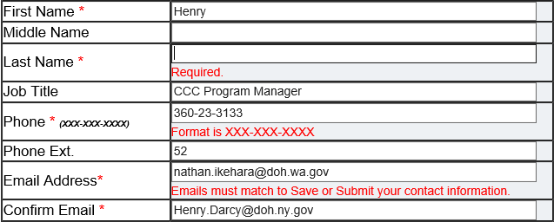
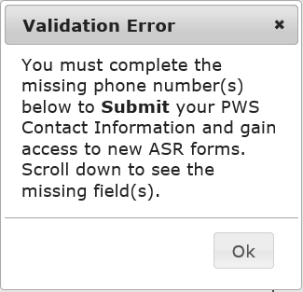
Contact Screen Notes—3
If you fail the data error checks, you’ll remain on the Contact Information Screen. You may see:
Scroll down and correct the problem fields and repeat Submit process until successful
OR

Slide 42
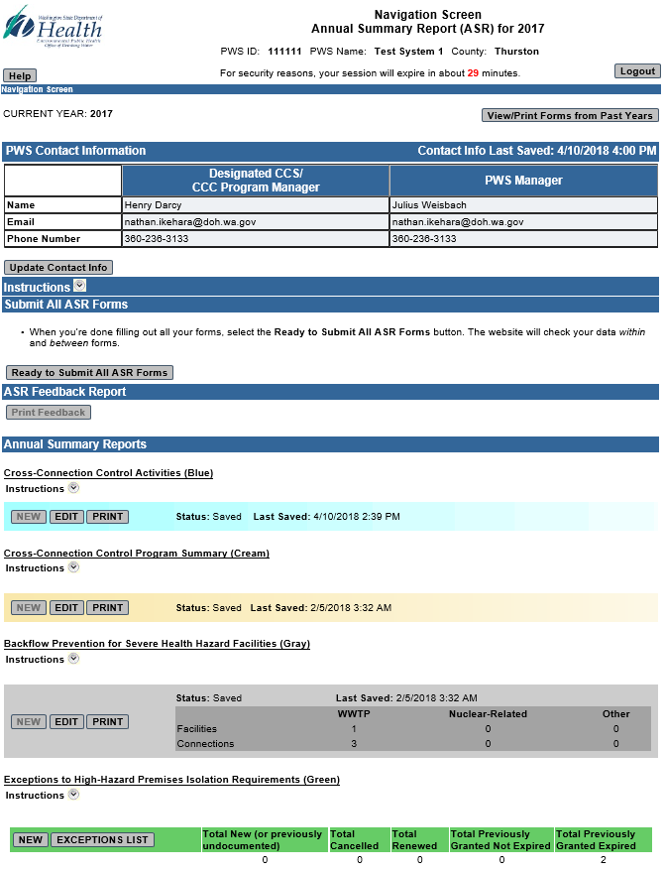
Navigation Screen—Notes
Access new 2017 ASR forms
Edit and print saved 2017 ASR forms
Check on the status of any ASR form
  Not started
  Saved
  Ready to Submit
  Certified/Submitted
  Unsubmitted

Slide 43
Navigation Screen—Notes
If applicable, view summary info for
  Gray form data
  Green form data
If applicable, access the Exceptions List
Start the ASR forms submission process
Also initiate the “Unsubmit” process

Slide 44
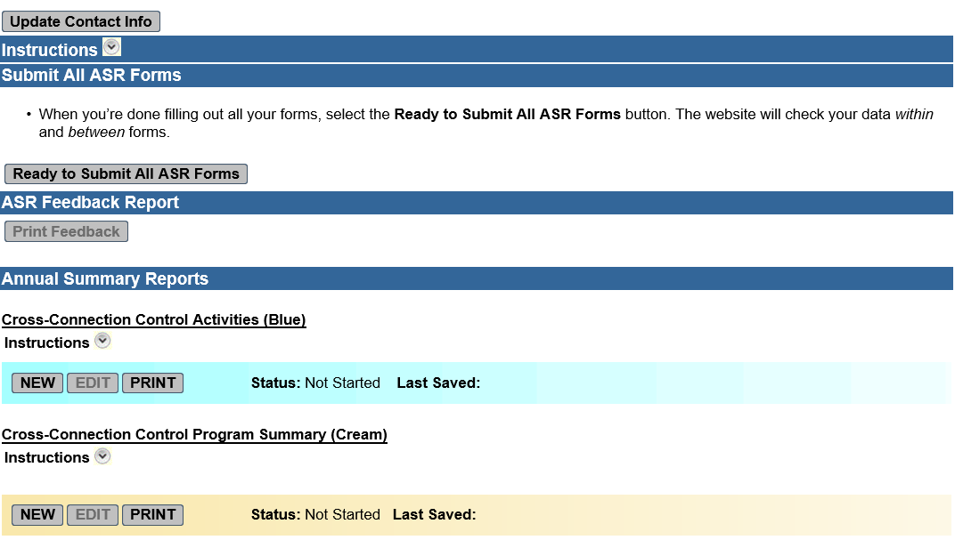
Navigation Screen—Step 2
Step 2: Start a New Form after you successfully Submit your Contact Info (complete Step 1)

Slide 45
ASR Website—Live Demonstration
Blue Form Completion

Slide 46
Annual Activities Report (Blue)
Focus: CCC program development and implementation
Written CCC Program status
Backflow prevention for Table 9-type hazards
Backflow preventer inventory
Other implementation activities

Slide 47
Select New Blue Form from
Navigation Screen
Click New to start a 2017 blue form
This will trigger the Import Pop-Up

Slide 48
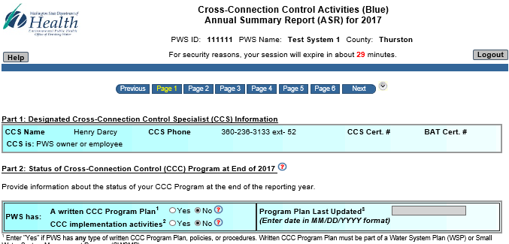
Blue ASR Form Completion
Click Yes to import 2016 data onto 2017 form
Click Save and start editing 2017 ASR form

Slide 49
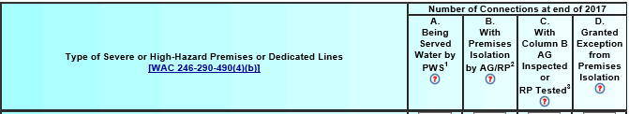
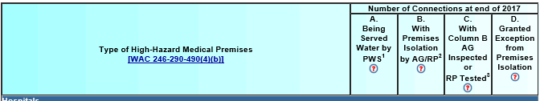
Backflow Prevention for Table 9 Premises
Part 3B (Page 2)
Part 3C (Page 3)—Medical High Hazard

Slide 50
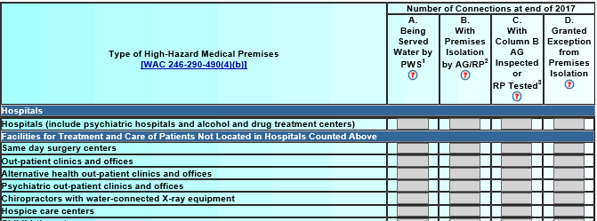
Grayed Out Fields
Reduce Blue Form Data Logic Errors
Selecting “No” triggers the website to gray out Medical Premises Table (page 3) to prevent entry of illogical data.

Slide 51
Blue Form Pages 2 and 3 Notes
Critical to accurately report status of backflow prevention for Table-9 type premises
DOH uses this data as basis of CCC compliance
Page 2 Table 9 “Hospital/Medical Facilities” row
  Website imports totals from page 3 for this row
  You can’t edit page 2 hospital (grayed out) row
  Edit page 3 values to change display on page 2

Slide 52
Blue Form Pages 2 and 3 Notes (2)
Remember—Table 9 is not all inclusive!
Add “Other” rows for high-hazard premises not on Table 9 (like marijuana grow operations)
Don’t enter None, N/A, or “0” in “Other” rows if not applicable! Leave blank!
See footnote for “counting” instructions

Slide 53
Blue Form (Pages 2 and 3)
A | B
“Being Served Water by PWS¹” | “With Premises Isolation by AG/RP²”
Count all connections to severe and high-hazard premises served | Count only those Column A connections with premises isolation RPs or air gaps
¹Count multiple connections or parallel installations to the same premises as separate connections. ²Count only connections with premises isolation AGs or RPs. Don’t include connections with in-premises preventers only or connections with DCVAs or DCDAs installed for premises isolation. The number in Column B can’t be larger than the number in Column A in the same row.

Slide 54
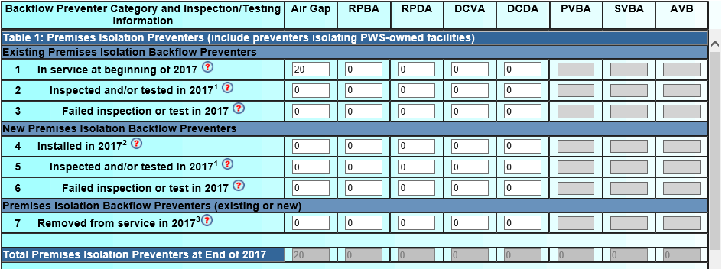
Blue Form Inventory
Part 4A (Page 4)

Slide 55
Blue Form Inventory Notes (Page 4)
Critical to report testing failures, i.e. any time assembly doesn’t pass one field test in the reporting year
Remember—ASRs are public records
Legislators may use assembly failure rate
data to justify dropping annual testing
Plumber Certification Law

Slide 56
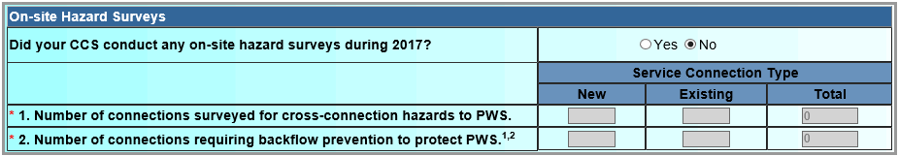
Blue Form Notes (Page 5)
Part 4B: Other Implementation Activities
  On-site hazard survey questions—read carefully!
Part 5: Backflow Incidents, Risk Factors and Indicators
  WAC requires PWSs to report backflow incidents and complete Backflow Incident Report form
  Water outage events should include both planned and unplanned events
  Expect systems to track information requested

Slide 57
ASR Website—Live Demonstration
Individual ASR Forms
Ready to Submit Process
and
In-Form Data Errors

Slide 58
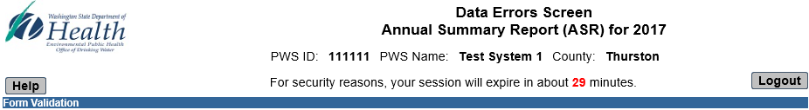
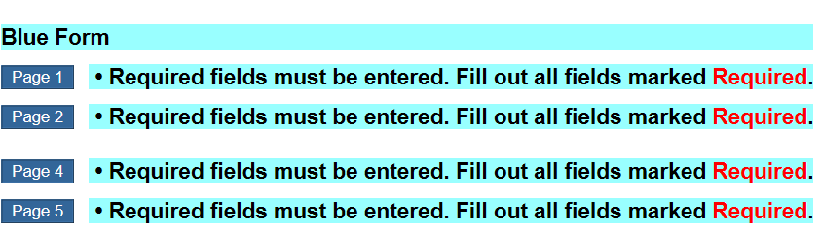
Blue Form
Within Form Data Errors Check
Click Ready to Submit. If Data Errors Screen appears, click page links to jump to errors

Slide 59
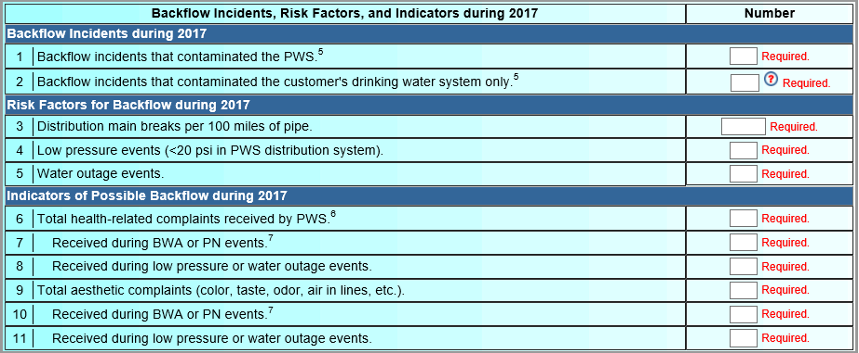
Example Required Fields
Data Error Messages Page 5

Slide 60
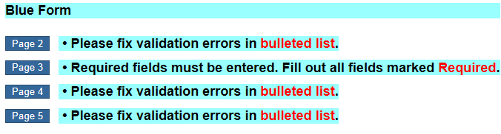
Example Blue Form Data Logic
Error Message Page 2
Website checks for data logic (validation) errors in addition to required fields

Slide 61
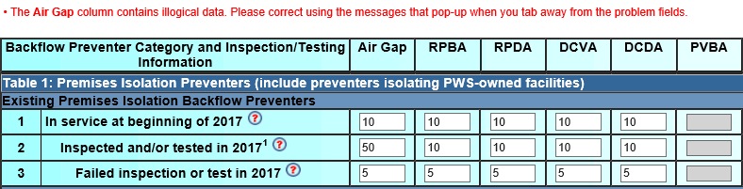
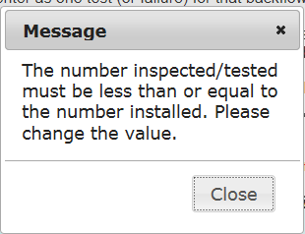
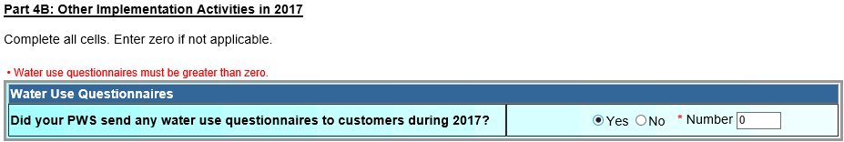
Example Data Logic
Error Messages Pages 4 and 5

Slide 62
Resolve All Within-Form Data Errors
Complete all required fields
“Required” will disappear when you tab away from completed field
Correct all illogical data
Click Ready to Submit again

Slide 63
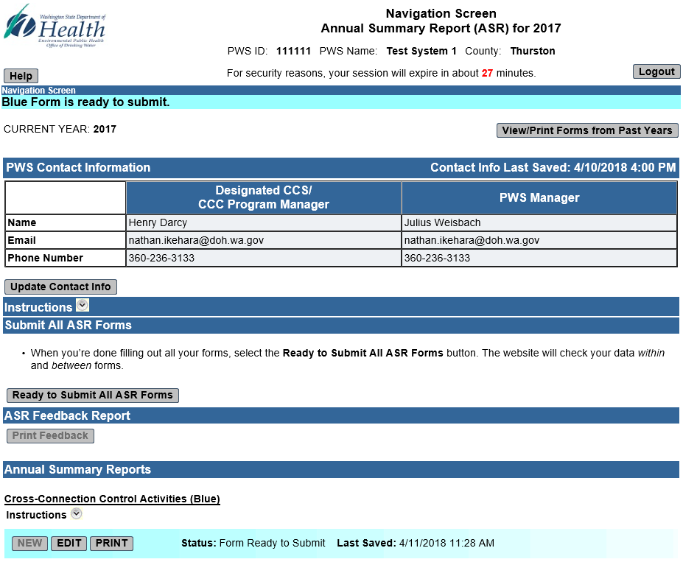
Repeat Ready to Submit Process until Form Status Changes
Repeat process until form status changes

Slide 64
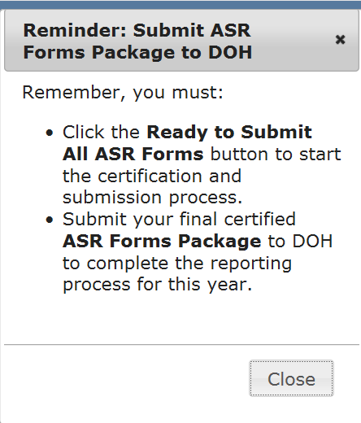
Reminder to Submit
ASR Forms “Package” to DOH

Slide 65
ASR Website—Live Demonstration
Cream Form Completion

Slide 66
CCC Program Summary (Cream)
Focus: written CCC Program Plan, policy, and procedures
Program type, compliance options
CCC responsibilities
Policies—auxiliary supplies, irrigation, Exceptions, etc.

Slide 67
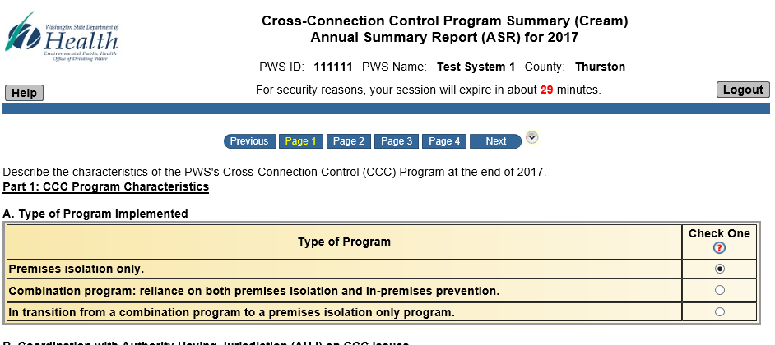
Repeat Start a New Form Process
On Navigation Screen, click New to start a 2017 cream form
Click Yes at import prompt and start editing data

Slide 68
Cream Form Reminders
Most fields are required
Includes data logic and grayed out fields
Page 3 Part 1L controls access to:
  New green forms (cream row 2)
  Past green forms (cream row 3)
Website completes Part 1L row 3
based on historic green form data

Slide 69
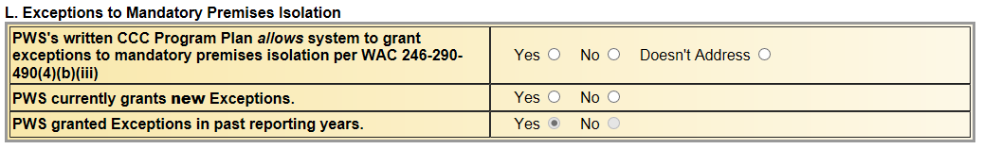
Cream Form Page 3 Part 1L
Exceptions to Premises Isolation
PWS must complete rows 1 and 2
Row 3 will be grayed out/disabled since website completes for you
You can’t change data in row 3!

Slide 70
ASR Website – Live Demonstration
Ready to Submit All ASR Forms
and
Forms Package
Certification and Submission Process

Slide 71
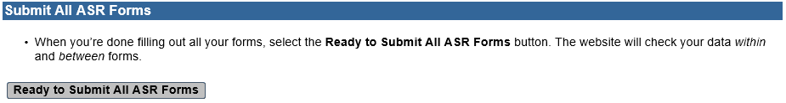
Check ASR Form Status
When you’re done filling out required ASR forms, check Navigation Screen
When each required ASR form’s status = Ready to Submit, start the submit process
Click Ready to Submit All ASR Forms on the Navigation Screen

Slide 72
Ready to Submit All ASR Forms
Ready to Submit All ASR Forms triggers website to check data in and between forms
If the Data Errors Screen displays, resolve all the errors listed
Repeat Ready to Submit All ASR Forms process until ASR Forms Package Certification and Submission Screen displays

Slide 73
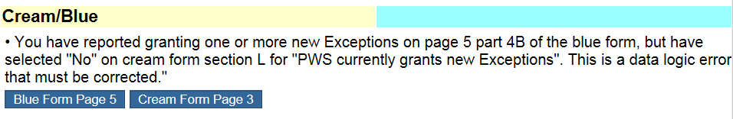
Between Form Data Error Example
Click on form page links to assess problem
Correct one or both forms to fix the data logic error(s) between forms
Click Ready to Submit on corrected form(s) and Ready to Submit All ASR Forms again

Slide 74
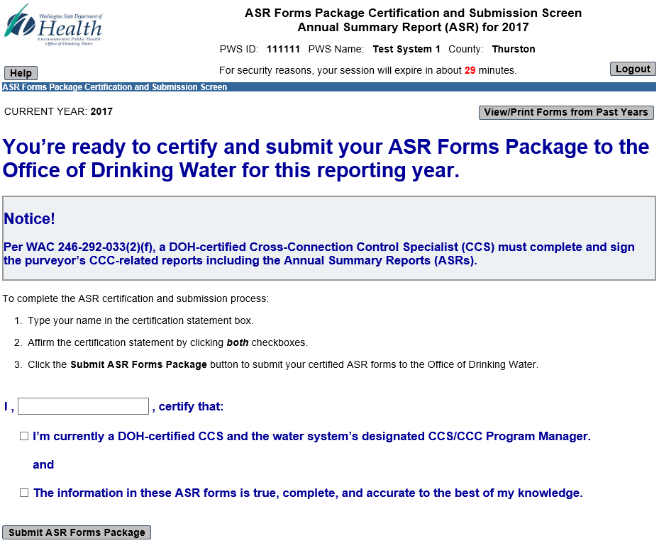
Certification and Submission Screen

Slide 75
Certifying and Submitting
ASR Forms Package
Designated CCS must certify and submit ASR Forms Package
  Type name in box and affirm certification statement by clicking both checkboxes
  Click Submit ASR Forms Package button
Forms Package Submission Confirmation Screen will display

Slide 76
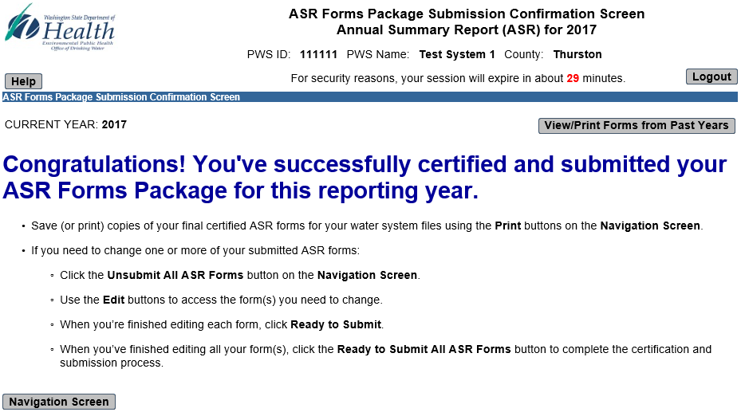
Forms Package Submission Confirmation Screen
Remember to save or print copies of final certified ASR forms for your PWS files

Slide 77
ASR Feedback Report
New for 2017 reports as an attachment to the submission confirmation email and available on ASR Website
Intended to help utilities and Department of Health staff evaluate the effectiveness of Cross-Connection Control program efforts

Slide 78
ASR Feedback Report (Continued)
Displays historical annual data for:
  Status of Written CCC Program
  CCC for Severe Health Hazard Facilities
  CCC for High-Hazard Premises
  Backflow Preventer Inspection and Testing Data
  Hazard Surveys
  Backflow Incidents, Risk Factors, and Indicators

Slide 79
Annual Summary Report (ASR)
Helpful Hints

Slide 80
Complete Remaining ASR Forms
Repeat data entry and Ready to Submit process on other required ASR forms (gray, green)
Remember
  Blue form page 2 controls gray form access
  Blue form page 5 and cream form page 3 control access to new and past green forms
When status of all forms = Ready to Submit, click Ready to Submit All ASR Forms button on Navigation Screen to trigger between form data error checks

Slide 81
Resolve Between-Form Data Errors
If Data Errors Screen displays, resolve between-form data logic issues
Change data on either or both forms identified on the Data Errors Screen
Repeat Ready to Submit All ASR Forms process until you resolve all between-form data errors
See next slides for examples

Slide 82
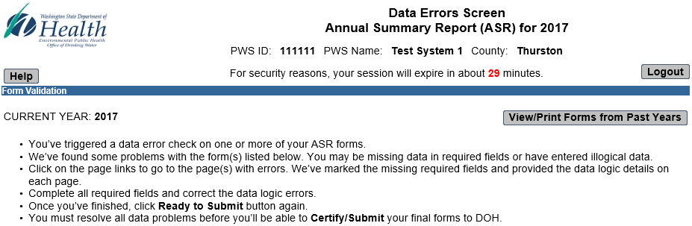
Data Logic Between Forms
(blue/gray example continued)

Slide 83
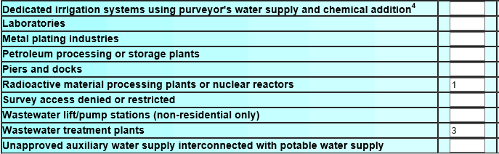
Data Logic Between Forms
(blue/gray example)
Data entry in either of these rows on page 2 of the blue form triggers a gray form requirement. User must submit a gray form to complete the ASR submission process.
On gray form, PWS must report 4 connections: 1 in nuclear-related category and 3 in WWTP category

Slide 84
Annual Summary Report (ASR)
Final Thoughts

Slide 85
ASR Helpful Hints Summary
To avoid data loss, don’t let your session time out
Make sure data is accurate, complete, and logical (within and between forms)
Save (or print copies) of your final forms
Call or email us if have any problems!

Slide 86



Contact Information
William.Bernier@doh.wa.gov
(360) 236-3562
Steve.Deem@doh.wa.gov
(253) 395-6767
Nathan.Ikehara@doh.wa.gov
(509) 509-2124
www.DOH.WA.Gov/DrinkingWater
Notes:
CONTACT SLIDE 1
Quick Help Tips
Contact 1 Box Box:
just add text
Photo Box:
click on the icon in the middle of the box to insert photo
photo will automatically size to fit the square
photo size can also be adjusted
Name/Title/Program Boxes:
just add text
Web Address Box:
add web address or use as is
Social Media Icons:
these images are not editable or linkable
they only denote DOH’s presence in these platforms

Slide 87
Annual Summary Report (ASR)
Helpful Hints for
Proper Completion of
Blue Form

Slide 88
What is “Premises Isolation”?
Method of preventing contamination of the public water system
Concept: isolate the customer’s plumbing system from purveyor’s distribution system
Other terms: service protection, containment

Slide 89
Premises Isolation Backflow Preventers
Install preventer on service line at either:
  Meter or property line
  An alternate location acceptable to the purveyor usually where service line enters customer’s building
If installed in alternate location, must still function as a premises isolation preventer
Mandatory for all severe and high-hazard premises per WAC 246-290-490

Slide 90
Premises Isolation Backflow Preventer
Water Main
Property Line
Table 9 High-Health Hazard Premises
DOH-approved RPBA for premises isolation to protect public water system

Slide 91
What is “In-Premises Prevention”?
Method of preventing contamination of consumer’s water system (plumbing)
Install backflow preventers at or near point of hazard (plumbing fixture) or to isolate an area (lab wing)
Other terms: internal protection, fixture protection, area isolation

Slide 92
In-Premises Backflow Preventers
PWS may rely on only when premises isolation is not required
Not applicable to severe or high-hazard premises!
Required by Uniform Plumbing Code (UPC) amended for Washington
Enforced by Authority Having Jurisdiction (AHJ), usually the local city or county building official

Slide 93
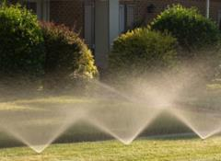
In-Premises
Backflow Preventer Installation
Water Main
Property Line
Backflow preventer installed (per UPC)

Slide 94
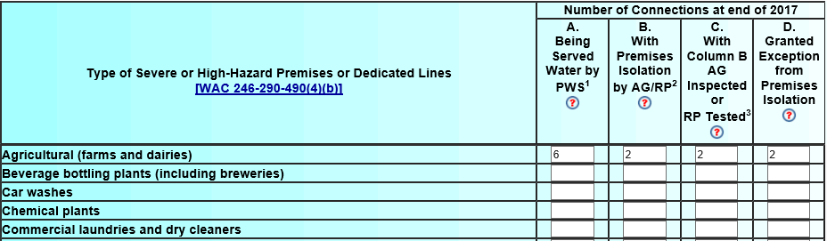
Blue Form Column B (pages 2 and 3)
In Column B, don’t include connections:
  With DCVAs for premises isolation
  Where PWS relies solely on fixture prevention or area isolation (no premises isolation)

Slide 95
Blue Form Medical Table (page 3)
Common question: how should PWS report connections that serve more than one type of medical facility
Count connection under medical category that poses the highest hazard to water system
Don’t count same connection more than once on Medical Category Table!

Slide 96
Blue Form Inventory—Failures
Failure is any time
  Assembly doesn’t pass at least one field test in reporting year
  Air gap doesn’t pass at least one inspection in reporting year
Count multiple failures of same assembly as one failure for the reporting year
Report the failure, even if assembly passes test after cleaning or repairs

Slide 97
Blue Form Inventory—Detectors
Count each detector assembly only once (don’t count bypass separately)
Count as one test the tests of mainline assembly and bypass assembly
Count as one failure the failure of:
  Either the mainline or bypass assembly; or
  Both the mainline and bypass assemblies
If take entire assembly out of service, count removal once

Slide 98
Annual Summary Report (ASR)
5 Minute Break
If you only fill out blue and cream forms…
you’re done now!

Slide 99
Annual Summary Report (ASR)
Gray Form Completion

Slide 100
Severe Health Hazard Form (gray)
Focus: status of backflow prevention at severe health hazard facilities (SHHFs)
Must complete, only if water system serves one or more:
  Wastewater treatment plants
  Nuclear reactor or radioactive material processing plants
Blue form page 2 data (nuclear, WWTP rows) controls gray form access

Slide 101
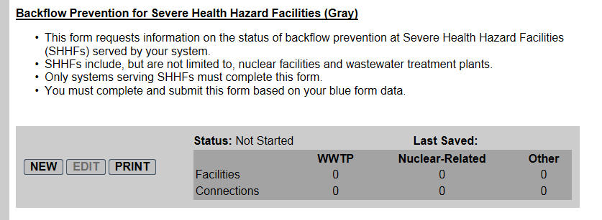
Access New Gray Form
Access new gray form from Navigation Screen
Click Yes at Import prompt and start editing data as needed

Slide 102
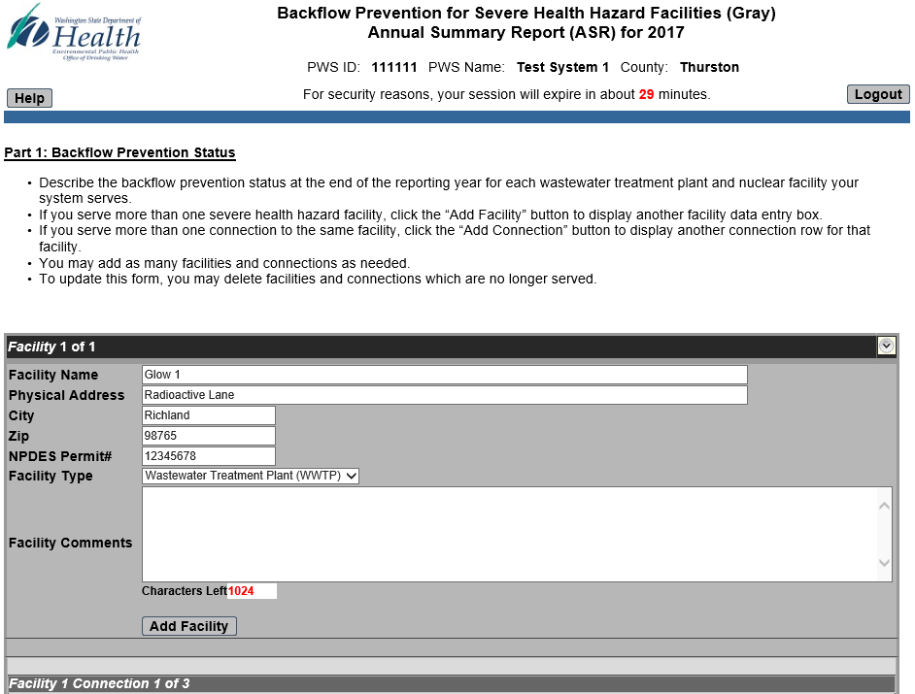
Gray Form Improvements
Multiple Connections/Facility

Slide 103
Annual Summary Report (ASR)
Green Form Completion

Slide 104
Exceptions Report (green)
Focus: exceptions to mandatory premises isolation
Must complete only if water system grants Exceptions now or granted in past
Per WAC, PWS must document reason Exception granted
Case-by-case documentation

Slide 105
Access to New Green Forms
Access to new green forms on Navigation Screen initially disabled
New button appears grayed out (disabled)
Website continues to block access until PWS saves either a:
  Blue form that reports on page 5 that PWS granted new Exceptions in reporting year; or
  Cream form that reports on page 3 Part 1L that PWS grants new Exceptions

Slide 106
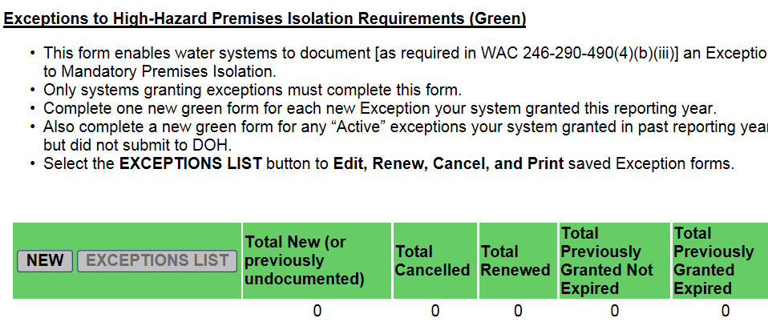
New Green Form Access Unblocked

Slide 107
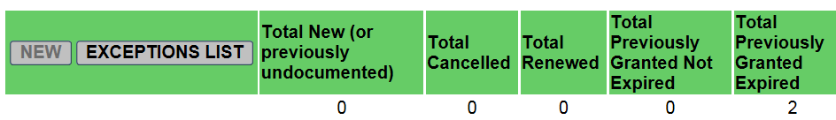
Accessing Saved Green Forms
Access saved green forms from the List of Exceptions
Click the Exceptions List button on the Navigation Screen to access the List of Exceptions

Slide 108
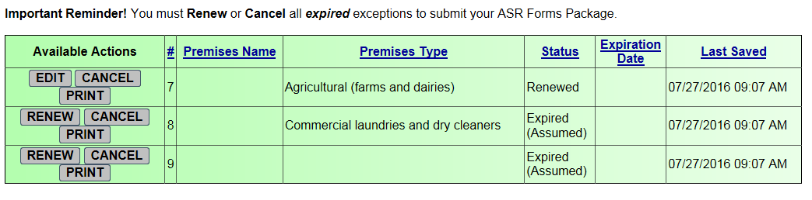
Edit, Renew, and Cancel Exceptions
List of Exceptions table displays Exceptions by premises name and shows status
From this screen, you can:
  Edit, cancel, and print new Exceptions
  Can renew, cancel, and print expired Exceptions

Slide 109
Address All Expired Exceptions
Check status on Exceptions List
“Expired” status means either:
  Expiration date falls on or before the end of reporting year
  No date originally entered (field blank)
Must address expired Exceptions - either:
  Cancel if no longer valid; or
  Renew if still valid

Slide 110
Cancelling Exceptions
To cancel an Exception, click Cancel and complete Exception Cancellation Form
Complete all fields on form including Cancellation Reason
On Submit, status on Exceptions List will change to Cancelled and display only in year in which cancelled

Slide 111
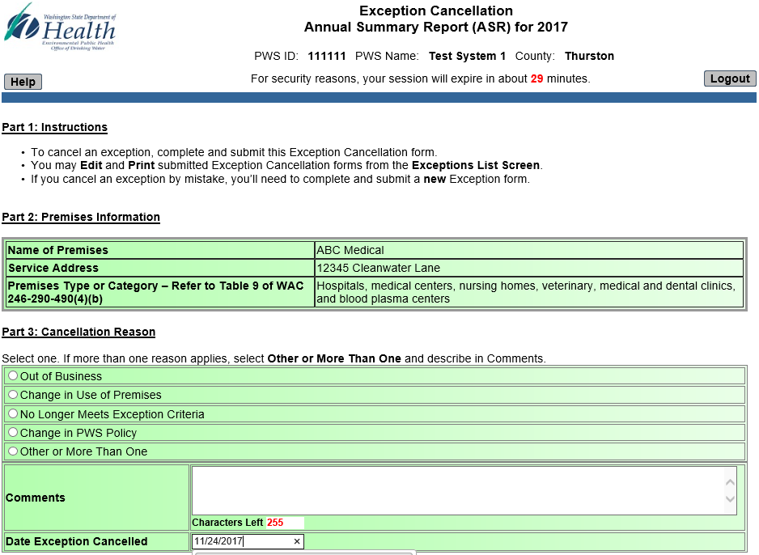
Cancellation Form

Slide 112
Renewing Exceptions
To renew an Exception, click Renew and complete an Exception Renewal Form
Make sure you select a Table 9 category from dropdown
Complete all required fields on form
Upon Submit, status on Exceptions List will change to Renewed

Slide 113
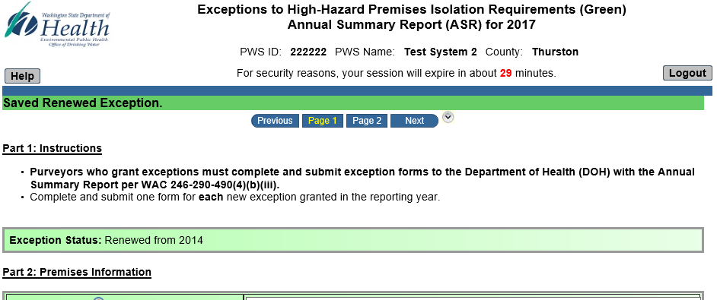
Renewal Form

