Slide 1
Respiratory Protection Program – LTC N95 user training Template
Healthcare-Associated Infections and Antimicrobial Resistance Section
Office of Communicable Disease Epidemiology
Disease Control and Health Statistics Division
DOH 422-223 June 2023

Slide 2
Use this template to customize training specifically for your facility
and always follow L&I guidance.
L&I Consultation Services: https://www.lni.wa.gov/safety-health/preventing-injuries-illnesses/request-consultation/
DOH Fit Test Project: HAI-FitTest@doh.wa.gov
Instructions: Remove the first two slides and replace the text highlighted in green with your facilities information.

Slide 3
Employee Respiratory Protection Program Training

Slide 4
Overview
This training is for employees who need to wear respiratory protection (e.g., N95) during their work.
This training covers:
Why respirators are needed and how they work
When and how to use a respirator
Medical evaluation and clearance for wearing a respirator
Training requirements
How to safely put on (don) and take off (doff) a respirator
Fit testing requirements
Unusual circumstances

Slide 5
Introduction
Why do I need to do this?

Slide 6
Federal and State Regulatory Requirement
Your employer must provide you with protection against known hazards in the workplace
Washington Administrative Code – WAC 296-842
OSHA Respiratory Protection Standard 29 CFR1910.134 and 29 CFR 1926.103

Slide 7
What are Respiratory Hazards?
Exposure happens when you breathe in hazardous particles, fumes, gases, or vapor
Exposure to respiratory hazards can cause illness and even death. Respiratory hazards can be biologic, chemical, etc. Examples:
Biological: TB, COVID-19, measles, flu
Other particles: wood dust
To be protected, you must wear a respirator (e.g., N95) if you:
Work with a positive or suspected positive COVID-19, TB, or other airborne precaution resident/client
Enter the room/area in isolation precautions for COVID-19
Perform some tasks that cause secretions to aerosolize with certain condition*
*Check current CDC and State guidance

Slide 8
Responsibilities - Employer
Your facility must provide a Respiratory Protection Program (RPP). Both you and your employer have responsibilities to keep you safe.
Employer responsibilities
Allow employees time to complete the tasks and trainings for the Respiratory Protection Program during paid work hours
Identify a person as the Respiratory Protection Program Administrator (also called Respirator Program Administrator or RPA). This person will be the point person for employees, vendors, and will create and maintain the written RPP.
Identify respiratory hazards at work
Provide NIOSH approved respirators (e.g., N95) and timely replacements for employees whose tasks require respiratory protection
Provide medical evaluation, training, and fit testing for employees
Provide a plan for accommodations if the employee is not able to use a respirator

Slide 9
Responsibilities - Employee
You have responsibilities to help keep you safe and healthy
Employee responsibilities are to... (in this order):
Complete the medical evaluation provided by your employer.
Complete this N95 training BEFORE you schedule your respirator fit test.
Get your N95 fit test done BEFORE using the N95. The fit test will make sure it will protect you and the tester will see if you understand how to put it on and take it off.
If you have questions, contact your RPA or ask the person doing your fit testing.
Use the N95 the way you were trained. It will protect you if used correctly.
Replace your respirator as needed.
Repeat the medical evaluation AND fit test when indicated.
Repeat the respirator training every 12 months.

Slide 10
Particulate Filtering Facepiece Respirators
WHAT IS THE N95 RESPIRATOR AND WHAT DOES IT DO?

Slide 11
N95 Respirator
What does the N95 respirator do?
It is a tight-fitting respirator. When used properly, it filters out 95% of the hazardous particles in the air.
If it does not fit tightly against your face, it will not protect you.
Examples of respiratory hazards: COVID-19, aerosolized flu, measles, etc.
What the N95 cannot do:
It cannot provide additional oxygen. It only filters (purifies) air you breathe.
It cannot protect you from vapors or gases. Vapors and gases can pass through the N95 filter.
It cannot protect you if oil is present in the air. Oil changes how the N95 filter works. For oils, choose a different type of respirator (for example, P95 or P100).

Slide 12
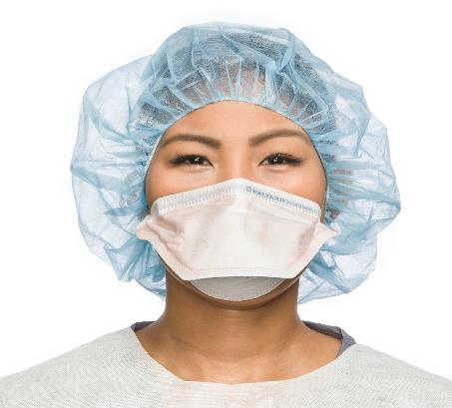
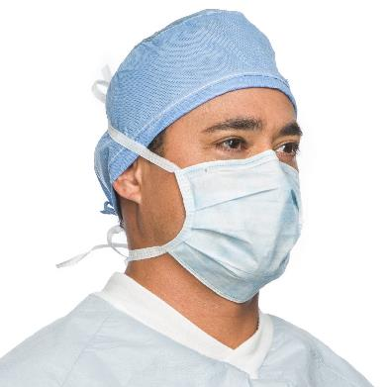
N95 Respirator vs. Mask
The N95 respirator fits snugly on your face without any gaps.
The surgical mask does not fit snugly on your face and does not have the material to filter out the virus.
N95 “Duckbill”
Surgical Mask
Important!
A surgical mask is NOT a respirator!
N95 fits tightly on the face
Does not fit tightly, allows air to flow in and out of the mask.
Halyard product: Retrieved from https://products.halyardhealth.com/infection-prevention/facial-respiratory-protection.html
Products.halyardhealth.com

Slide 13
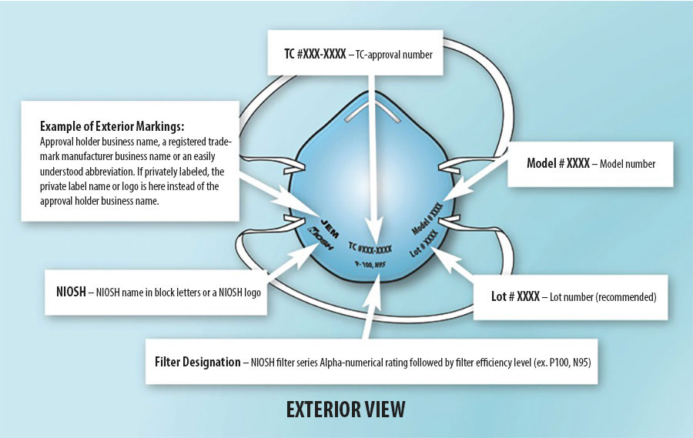
NIOSH Approved N95 Respirator
The National Institute of Occupational Safety and Health (NIOSH) evaluates respirators to be sure they will be effective.
Important! The respirator used must be NIOSH approved. Be sure these markings are on your N95 before you use it! Counterfeit respirators have been found!
CDC NIOSH – Approved Particulate Filtering Facepiece Respirators, https://www.cdc.gov/niosh/npptl/topics/respirators/disp_part/default.html, accessed 5/23/2023

Slide 14
Medical Evaluation and N95 Respirator Training
WHY DO I NEED TO DO THE MEDICAL EVALUATION AND TRAINING?

Slide 15
Medical Evaluation
You need a medical evaluation because wearing the N95 can:
Put a strain on your body because it is tight-fitting
Make it harder to take a breath when breathing through the filter. Also, your breathing rate may increase when you are doing your work activities.
The medical evaluation will help determine if you are able to use the N95 respirator safely
The information you provide is CONFIDENTIAL. Your supervisor/ manager/employer will not have access to the questionnaire you complete.
The Licensed Health Care Provider (LHCP) doing the evaluation keeps the medical records
Your supervisor/manager/employer will only know if you are approved, or not approved, to use a respirator
Notes:
NOTE: According to L&I, the questionnaire will need to be kept for 30 years post termination. The approval document can be discarded after expired; however, it may be wise to keep the past 5-7 years on hand.

Slide 16
Medical Evaluation (cont.)
You need to repeat the medical evaluation when:
Your recommendation letter expires
Your RPA or supervisor tells you to do it again
You have difficulty breathing or other issues while wearing a respirator
There is a change in worksite conditions that may stress your body
You have a major health change, such as:
Lung/respiratory problems, cardiac changes, stroke, etc.

Slide 17
Training
Correctly donning and correctly using the N95 will best protect you. Learning how to do it right is very important.
As required by law, you must understand:
Why you need to use the N95 respirator
What the N95 respirator can and cannot do for you
How the respirator works
How to put on (don) and take off (doff) the N95 respirator
What to do in case the N95 respirator is not working or comes off your face
Storing the N95 respirators
What the annual requirements are to keep using the N95 respirator

Slide 18
Donning the N95
What is the right way to don (put on) the N95?

Slide 19
Requirements Prior to Using the N95
Tie back long hair so it is away from your face
Remove glasses, facial jewelry (if located on the lower face), and any hair coverings
Glasses or hair coverings may shift while you do your work. Wearing the N95 over glasses or head coverings can cause the seal to break and expose you to contaminated air.
Your face must be clean shaven (see the next slide for acceptable facial hair)
Facial hair or stubble may cause a break in the N95 seal on your face letting contaminated air enter your breathing space; inside the N95.
Important! The edges of the N95 respirator must be directly on your skin.

Slide 20
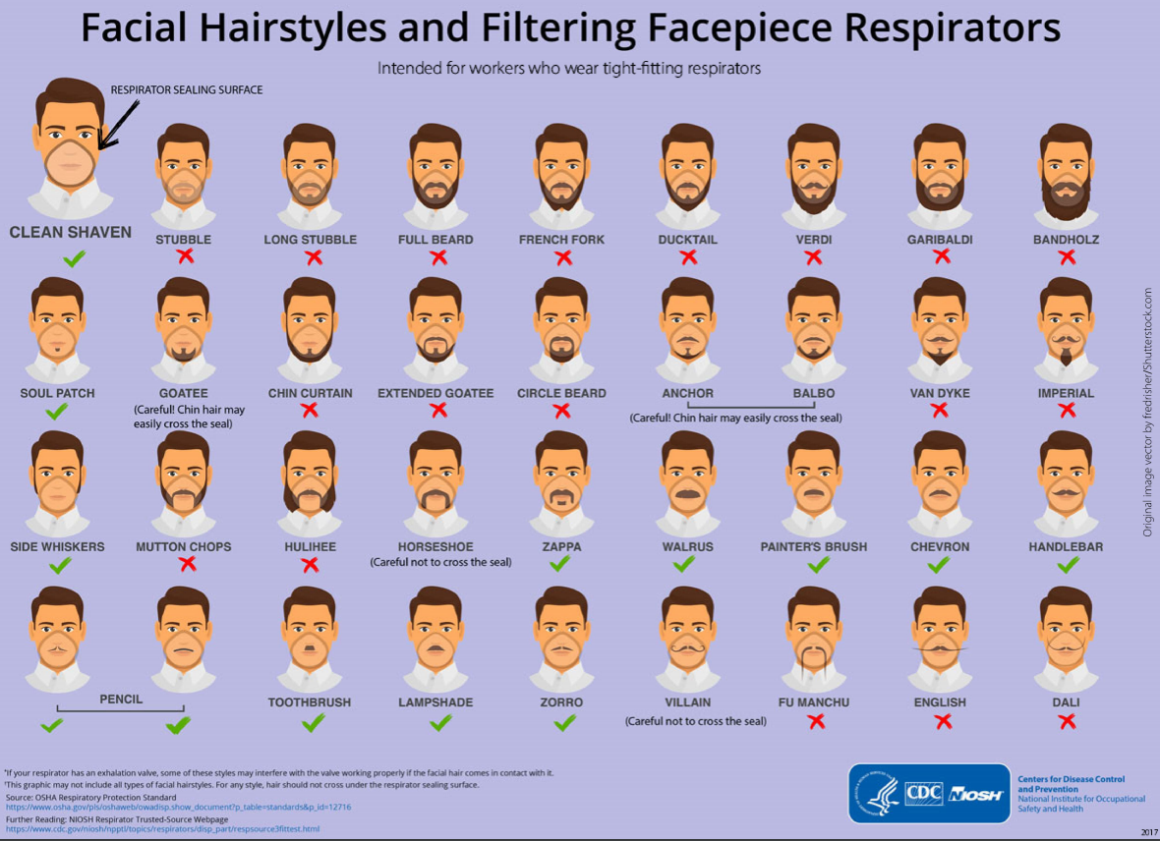
CDC Facial Hairstyles and Filtering Facepiece Respirators, https://www.cdc.gov/niosh/npptl/pdfs/facialhairwmask11282017-508.pdf, accessed 6/8/2023

Slide 21
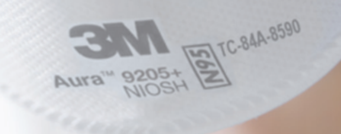
Step 1 – Inspect Your Respirator
Always inspect your N95 respirator!
Look for dirt, stains, tears, wetness, straps not attached, etc.
If your N95 has any of these, throw it out and get another one!
If the N95 is individually wrapped, do not use it if the wrapper is torn or taped!
Are the straps securely attached?
Test to see if the straps are firmly attached. You want the straps to keep the N95 snug to your face and not stretch or move once you put it on.
Check that it’s a NIOSH approved respirator
Counterfeit N95’s have been found! Do not use the respirator if the NIOSH stamp is missing!

Slide 22
Step 2 – Don (put on) the N95
After inspection, don the respirator using the techniques in the next slides
The next slides show how to don the three general types of N95 respirators.
Note: Donning the N95 may be different depending on the type of N95!
Tips!
The straps go as follows:
Top strap goes on top of your head
The bottom strap goes around your neck (under any hair)!
Use a mirror to check for:
Your hair is not under the respirator edges
The respirator edges are smooth and not folded
Correct strap placement
Do not apply pressure to the respirator to hold it in place

Slide 23
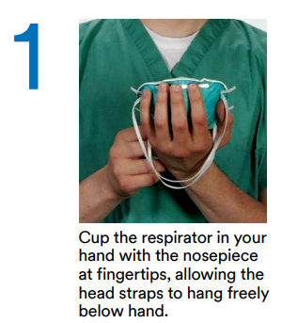
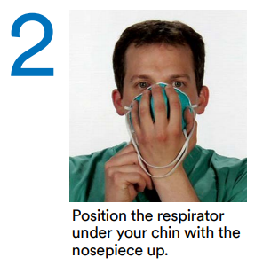
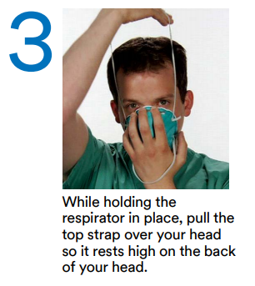
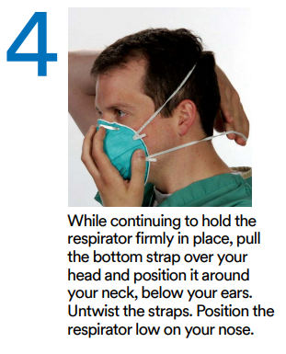
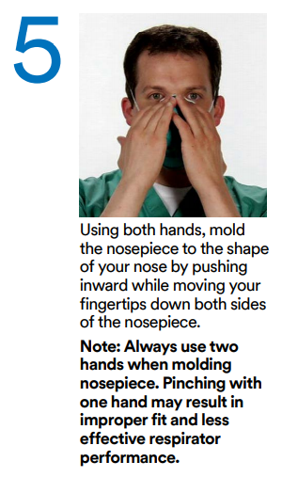
Step 2 – Don the N95 (cont.)
This example shows donning the 3M 1860 (cone-shape)
Note: This technique can also be used with the 3M 8210, and BYD* N95s (see the Resource slide).
* For foldable respirators such as BYD, unfold and flatten the metal nose piece first.
3M 1860/186s, https://multimedia.3m.com/mws/media/811783O/1860-and-1860s-wear-it-right-poster.pdf, accessed 5/23/2023

Slide 24
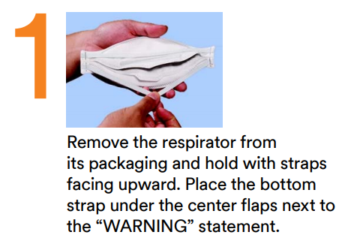
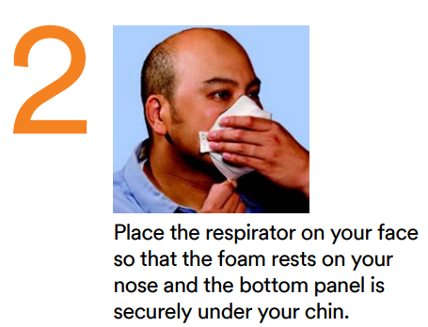
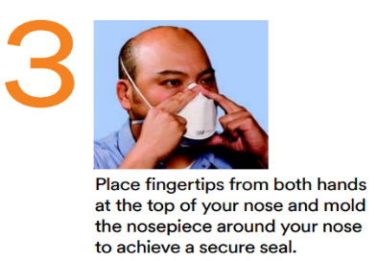
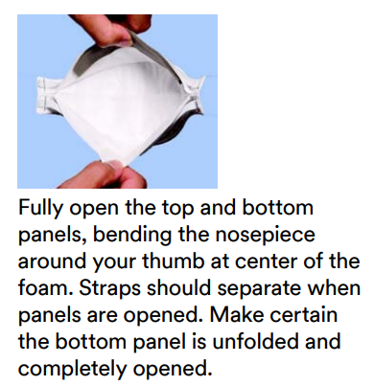
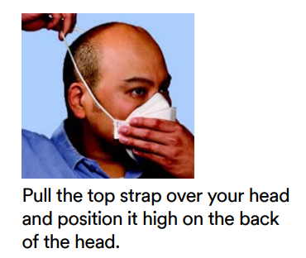
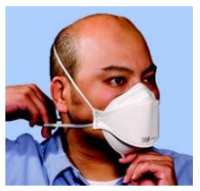
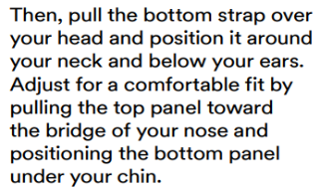
Step 2 – Don the N95 (cont.)
Three-Panel N95 (such as the 3M 9205+, 1870+, 9210+)
3M Aura Series Respirators Application, https://multimedia.3m.com/mws/media/827914O/3m-wear-it-right-aura-particulate-resp-english-poster.pdf, accessed 5/23/2023

Slide 25
Step 2 – Don the N95 (cont.)
Duckbill type of N95 such as the Halyard (formerly Kimberly Clark) N95
Separate the edges to fully open it.
Slightly bend the nose wire to form a gentle curve.
Hold it upside down to expose the two straps.
Use your index fingers and thumbs, separate the straps.
Hook the respirator under your chin.
Pull the straps up over your head.
Release the lower strap from your thumbs and position it at the base of your neck.
Position the remaining strap on the crown of your head.
Form the nose wire across your nose and cheeks, using both hands.
Halyard N95, Qualitative Fit Test Instructions, https://www.halyardhealth.com/wp-content/uploads/c15445_respirator_fit_test_instructions_brochure.pdf#:~:text=To%20User%20Seal%20Check%20a,her%20face%20and%20the%20respirator, accessed 5/23/2023

Slide 26
Step 3 – Perform a Seal Check
The purpose of the seal check is to see if air leaks when you put on your N95
To perform the seal check, place the palms of your hands on the respirator to cover the breathing area. By blocking the filter, air will be forced out toward your eyes and face if there is a leak.
Adjust the placement and metal nose piece until there are no air leaks
Perform a positive seal check and a negative seal check (check with respirator manufacturer) each time BEFORE entering the patient’s room
The seal check is NOT the same as a fit test!
Remember! Do a seal check each time you don an N95! The N95 seal helps keep the hazard from entering your breathing space. Do not skip this step!

Slide 27
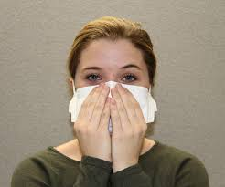
Positive and Negative Pressure Seal Check
NOTE: Do not press the respirator against your face. Your hands are to block the air from passing through the filter.
Positive Pressure
Cover the respirator as indicated by the manufacturer
Take a deep breath in and blow it out quickly
If you feel air blowing out on your eyes or anywhere else on your face, you must readjust your seal and check it again
Be sure to block the exhalation valve if your respirator has one
Negative Pressure
Cover the respirator as indicated by the manufacturer
Exhale gently, then take a quick deep breath in
Your respirator should either press against your face or collapse
If it does not press against your face or collapse, you must readjust your seal and check it again
CDC, Filtering out Confusion: Frequently Asked Questions about Respiratory Protection, https://www.cdc.gov/niosh/docs/2018-130/pdfs/2018-130.pdf, accessed 5/23/2023

Slide 28
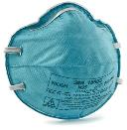
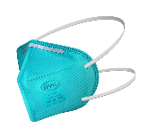
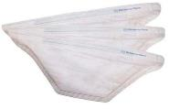
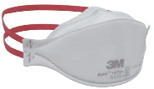
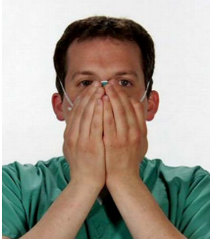
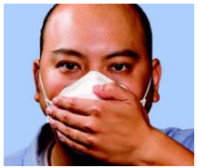
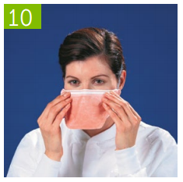
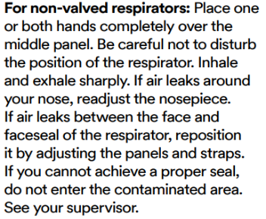
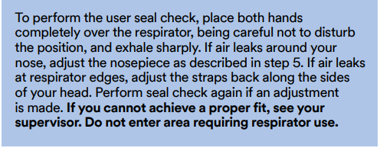
Step 3 – Perform a Seal Check (cont.)
Seal check with different style N95s:
Cone shape respirator, such as the 3M 1860, BYD
3 panel respirator, such as the 3M 9205+
“Duckbill”, such as the Halyard respirator
Forcefully or sharply inhale. The respirator should collapse as you breathe in. Now forcefully or sharply exhale. The respirator should expand or puff up when you breathe out. If air leaks when you are doing this readjust the nose wire, straps, and/or the respirator on your face. If you cannot get a proper seal, do not enter the patient’s room and see your supervisor.
See Resource slide for photo credits for each photo on this slide.

Slide 29
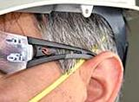
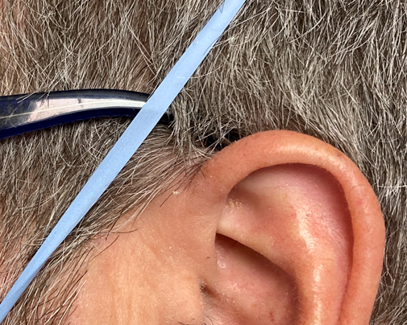
Step 4 – Wearing the N95 with other PPE
If you wear glasses or safety glasses, be sure the legs of the eyewear go over the N95 straps (not under the straps)
The same goes for face shields
YES
NO
Google images, OH&S, https://ohsonline.com/articles/2020/06/01/the-eyes-are-a-gateway-for-covid19-safety-eyewear-can-help.aspx, accessed 5/23/2023

Slide 30
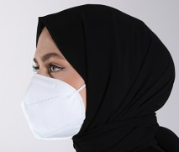
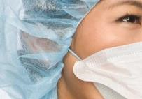
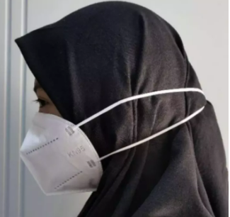
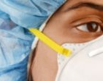
Step 5 – N95 and Head Coverings
The N95 straps must be on your hair, not your head cover!
YES
https://www.sefamerve.com/en/mask/ffp2-n95-yuz-maskesi-1-adet-1001-01--586145
Products.halyardhealth.com
NO
https://www.lazada.co.id/products/masker-kn95-n95-mask-5-ply-model-hijab-2-pcs-i4822856901.html
https://www.cardinalhealth.com/en/product-solutions/medical/infection-control/facial-protection/respirators.html

Slide 31
Doffing the N95 Respirator
WHAT IS THE RIGHT WAY TO TAKE OFF THE N95?

Slide 32
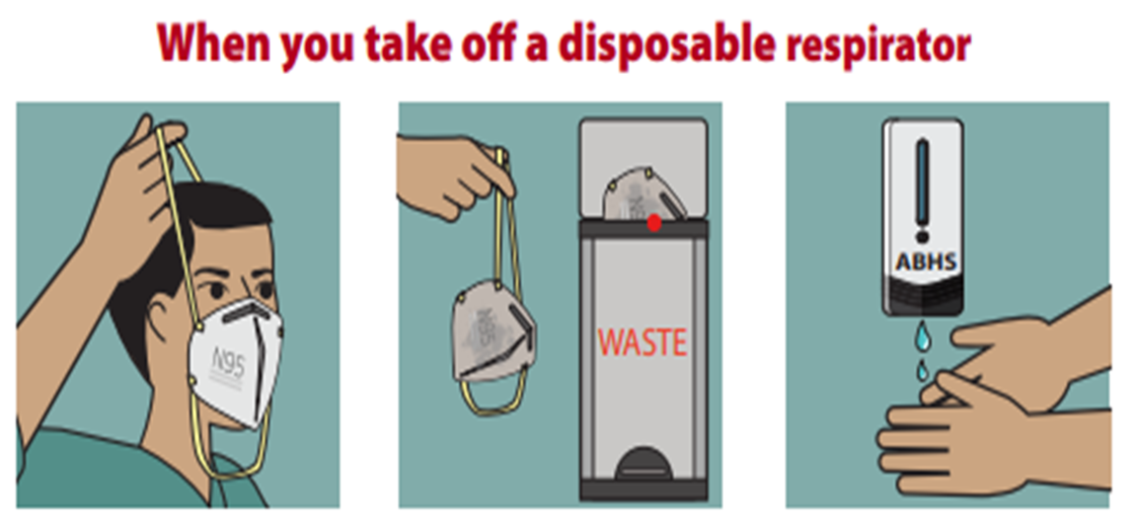
Doffing(take off)the N95
Always perform hand hygiene before removing your PPE
Remove your PPE and eye protection first. Your respirator is the last item to remove when you are in the clean air area!
Without touching the front of the respirator, bend slightly at the waist and lift the lower strap over your head. Then lift the remaining strap over your head.
Place your respirator in your paper bag or in the trash.
Wash your hands with soap and water or use a hand sanitizer .
CDC Respirator On / Respirator Off, https://www.cdc.gov/coronavirus/2019-ncov/downloads/hcp/fs-respirator-on-off.pdf, accessed 6/8/2023

Slide 33
Fit Testing
Why do I need to get fit tested?

Slide 34
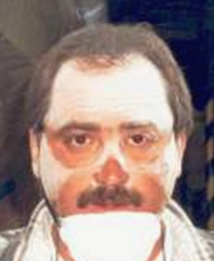
Why do I need a Fit Test?
You need a fit test because:
A well-fitted N95 helps protect you
Every shape of N95 respirator will fit your face differently, but not all of them will fit you correctly
It is an annual requirement
Your current employer may not have the same one that you used previously
Physical changes may affect the seal, such as:
Weight gain or loss of 20 lbs or more
Major dental work such as getting new dentures
Facial surgery or injury that has slightly changed the shape of your face
Imagine that the white powder is COVID-19.
https://lni.wa.gov/safety-health/safety-training-materials/training-kits, accessed 6/30/2021

Slide 35
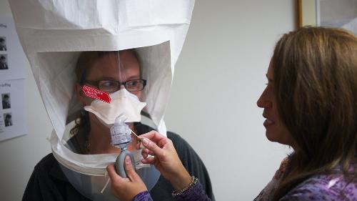
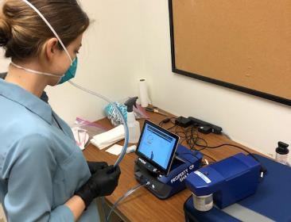
What is a Fit Test?
A fit test is a way to see if the respirator will correctly seal around your mouth and nose. The seal helps keep the hazard out of your breathing space.
A trained person must conduct your fit test
There are two types of fit testing methods: qualitative (uses a hood over your head) and quantitative (uses a machine). You will be fit tested using the qualitative method.
Qualitative Fit Testing
Quantitative Fit Testing
https://www.vdh.virginia.gov/emergency-preparedness/n95-respiratory-fit-testing-train-the-trainer/ accessed 4/12/2021
https://www.ucdavis.edu/news/volunteers-sought-fit-test-n95-masks accessed 4/12/2021

Slide 36
Preparing for Fit Test Day
Important! Complete these tasks before your fit test day:
Medical evaluation
It can be harder to breathe with the N95 on. The medical evaluation helps to be sure your body can tolerate using the respirator.
Training
Your employer will provide respirator training
Training covers how the respirator works, why you need it, when you need it, how to put it on and take it off, and what to do in case of emergencies
You must understand these topics before your fit test appointment
Your fit test time is for getting fitted and to review proper donning, doffing, and seal check.

Slide 37
Fit Test Day Reminders
Arrive at least 15 minutes prior to your scheduled fit test.
Important! Do not eat, drink (except for unflavored water), chew gum, smoke/vape, or apply any lip cosmetics including lip balm after you arrive. These items may affect your ability to taste.
If you are going to be late, please let your supervisor know.
Dress as you would when going into a resident’s room.
Examples: eye protection/face shield, glasses, hair covering, hair in a bun, etc.
If you have it, bring proof of your medical evaluation certificate/approval
This will let the person doing your fit test know you are able to use a respirator without causing harm to yourself. The letter is a requirement for the fit test.
Fit testing takes different amounts of time for each person. If there are several employees being fit tested, be prepared to spend time waiting your turn.
NOTE: If you have facial stubble, you will either be asked to shave or reschedule your appointment! Contact your supervisor if you are not willing to shave.

Slide 38
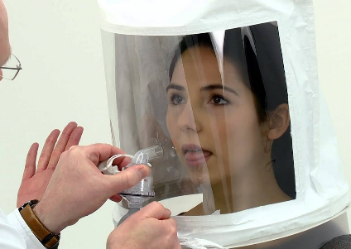
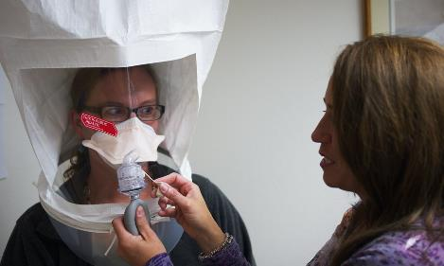
Steps for Fit Testing
The basic steps are:
The Sensitivity Test…
Then,
Put on (don) the N95
Seal check
Wear the N95 for 5 minutes
Start the fit test exercises
Take off (doff) the N95
Sensitivity Test
3M FT-10 Qualitative Fit Testing Kits, https://www.youtube.com/watch?v=PthSES4O9d8, accessed 6/14/2021
Fit Test
https://www.vdh.virginia.gov/emergency-preparedness/n95-respiratory-fit-testing-train-the-trainer/ accessed 4/12/2021

Slide 39
Fit Testing Solutions
There are two types of solutions used to fit test an N95 respirator:
Bitter – Bitrex (It is bitter and is used to prevent accidental poisoning. If consumed, it is completely harmless, but tastes terrible.)
Sweet – Saccharine (It is an artificial sweetener.)
The solution goes into a device that sprays a fine mist. The tester sprays the mist into the hood that covers your head (the hood rests on your shoulders).
The solutions should not irritate your skin or eyes
If you can taste the solution while wearing the respirator during the fit test, the respirator has failed the test.

Slide 40
Sensitivity Testing
The purpose of the sensitivity test is to see if you can taste the solution.
During the sensitivity test, you will have the hood on without a respirator
Your mouth will need to be open and your tongue slighting sticking out
You need to breathe through your mouth throughout the entire test
After you taste the solution, you must rinse your mouth with plain water to get the taste out of your mouth. Also, wipe around your mouth with a wet tissue to remove the solution on your skin.
Both the sensitivity and fit test solutions are safe to use
3M FT-10 Qualitative Fit Testing Kits, https://www.youtube.com/watch?v=PthSES4O9d8, accessed 6/14/2021

Slide 41
Fit Testing
The fit test uses a solution to help detect leaks in the seal of the N95 respirator during the fit test
With your N95 on, the tester sprays the fit test solution into the hood that covers your head.
You will be asked to breathe with your mouth slightly open.
If you taste the solution during the fit test, tell the fit tester and they will remove the hood.
Note: The solution will be on your hair and face.
https://www.vdh.virginia.gov/emergency-preparedness/n95-respiratory-fit-testing-train-the-trainer/ accessed 4/12/2021

Slide 42
Donning
Put on (don) the N95 and do your seal check
This is a good time to be sure you are doing it correctly. Have the fit tester double check your process.
Wear the N95 for a minimum of five minutes before fit testing starts.
This is to be sure the N95 is comfortable, and that you can tolerate the respirator on your face.
If at any time during the fit test you taste the solution, let the tester know immediately!

Slide 43
Fit Test Exercises
The purpose of the test is to see if the N95 seal on your face can be maintained while you perform movements you would normally make at work. Each exercise must be completed while standing and be repeated at a comfortable pace for 1 minute.
Normal breathing – This is to see if your seal is adequate
Deep breathing – Taking deep breaths will again test the seal
Turn head side to side – Slowly turn your head (chin toward shoulder), pause, and take a breath. Then, turn to the other side, pause, breathe.
Head up and down – Tip your head up toward the ceiling then down toward your feet. Take a couple normal breaths each time you move your head.
Talk out loud – Some testers may ask you to read out loud (e.g., Rainbow Passage), others may have you count out loud from 1 to 100 backward. Speak as if you are talking with the resident/client that is hard of hearing.
Bend over and stand up/Jog in place – Bend forward as if you are picking up something from the floor, and then stand up.
Do not let the hood fall off your head!
If you are not able to bend over, you can jog in place
Normal breathing – This is to test if any of the activities have caused your respirator to shift and break the seal.

Slide 44
Doffing and Completion of the Fit Test
Demonstrate the proper way to remove (doff) and dispose of the N95
If you have done all the activities and did not taste the solution, your respirator passed the fit test!
You are now fit tested to that make and model of N95 only
If your facility no longer has that type of N95, you will need to get fit tested again to the available N95s
Now that you are fit tested....
The respirator fit test is an annual requirement
The medical evaluation will need to be repeated as indicated by the Licensed Health Care Professional or when you have a change in health
The training will need to be completed every 12 months

Slide 45
Fit Testing Take-Aways
Your medical evaluation and training must be done first.
Facial hair and jewelry must not interfere with the N95 seal or the strap placement.
Bring your other PPE, head coverings, face shield, and/or eyewear to the fit test.
Be early or on time for your appointment. Notify the fit tester if you will be late.
No eating, drinking (except plain water), smoking/vaping, applying lip cosmetics including lip balm 15 minutes prior to the testing.
Notify the tester immediately if you taste the solution, or if you have any discomfort during the fit test.
Remember the solution is on your face and hair. Shower and wash your hair when you get home.

Slide 46
Decreasing Risk of Exposure
WHAT SHOULD I DO IF THE RESPIRATOR IS Bumped OUT OF PLACE?

Slide 47
Unusual Things Can Happen!
A resident/client or a co-worker may accidentally bump your respirator
A confused resident/client may pull off your respirator
Fluid can get on your respirator
If these things happen while you are in the isolation area:
Hold your breath and exit the isolation area as soon as possible!
Be sure the resident is safe
Perform hand hygiene before leaving the room
Outside the room, put on clean gloves and remove your respirator
Inspect your respirator. If damaged, get a new one.
Put on your N95 and perform a seal check before re-entering the room

Slide 48
Your Workplace
Things that are specific to your facility

Slide 49
Specific to your facility
Respiratory Hazard Identification
Hazards at [Name of Facility] are:
List hazard #1
List hazard #2
Our Respirator Program Administrator (RPA) is [Name of the person] and can help you with questions or concerns about the Respiratory Protection Program.
[If you hired outside your organization, indicate how to contact, office hours for this person]
Medical Evaluation
Our facility uses [name of the medical evaluator/service/clinic] as the Licensed Health Care Professional (LHCP) for medical evaluations. They will send you a letter indicating your ability to wear a respirator.

Slide 50
Specific to your facility
Respirator Information
We are currently using:
[List manufacturer, model of your respirator]
N95s are stored:
[location you stored]
You must use an N95 respirator when doing the following tasks:
Providing direct care with residents/clients who have or may have COVID-19
Performing housekeeping/cleaning tasks in rooms that have isolation/quarantine precautions for COVID-19
Tasks that aerosolize secretions (Aerosol Generating Procedures or AGPs)
[List other tasks]
[List other tasks]

Slide 51
Summary
What are the key things to remember?

Slide 52
Summary
Before your fit test, complete your:
Medical evaluation. Repeat as indicated by the LHCP.
Training before using the N95. Repeat every year.
Get fit tested before using the N95 for the first time, and then annually
NOTE: You will need a new fit test if you have 1) physical changes that would change how the N95 respirator fits on your face, or 2) if you use a different model, style, size, manufacturer of respirator.
Inspect your respirator every time before you put it on
Be sure the respirator is in direct contact with your body
Perform a seal check each time you don your respirator
Remove yourself from the room if you have issues with your respirator
Do not touch the front of the respirator when taking it off
Perform hand hygiene before and after you don or doff your respirator
If you have a question, talk to your Respirator Program Administrator!

Slide 53
Adapted from CDC, How Respirators Work, https://blogs.cdc.gov/niosh-science-blog/2018/01/04/respirators-public-use/ 5/23/2023

Slide 54
Term | Definition
Aerosol generating procedures | Procedures that can cause the secretions to become airborne
Doff | A term commonly used with PPE, to take it off
Don | A term commonly used with PPE, to put it on
Exhalation valve | A valve on a respirator that does not filter the user’s breath
Fit test | A way to test the fit of the N95 is snug enough to protect you from the virus
Mask | A general face covering, it is not a respirator
Medical evaluation | An evaluation to determine if your body can tolerate using the N95 respirator
N95 | A respirator that fits tightly on the face to filter out 95% of airborne particulates in a non-oil environment
NIOSH | National Institute for Occupational Safety and Health - Federal research agency focused on worker health and safety
OSHA | Occupational Safety and Health Administration - Federal Regulatory Agency for worker health and safety
PPE | Personal Protective Equipment - gloves, gown, mask, respirator, safety glasses/goggles, face shield, etc.
Respirator | A device that has a filtering system to filter out the hazard or can supply you with clean air to keep you from harm. Use only NIOSH approved respirators.
Seal check | To check the N95 seal on your face when you first put it on and at any time you think the seal may have been broken
Washington Department of Labor and Industry (L&I) | A Washington regulatory agency enforcing workplace health and safety standards

Slide 55
Resources
DOH SARS-CoV-2 Infection Prevention and Control in Healthcare Settings Toolkit, April 9, 2023 https://www.doh.wa.gov/Portals/1/Documents/1600/coronavirus/COVID19InfectionControlForAerosolGeneratingProcedures.pdf
3M 1860/1860s N95 Respirator Application & Removal, https://multimedia.3m.com/mws/media/811783O/1860-and-1860s-wear-it-right-poster.pdf, accessed 6/8/2023
3M Aura Series Respirators Application, https://multimedia.3m.com/mws/media/827914O/3m-wear-it-right-aura-particulate-resp-english-poster.pdf, accessed 6/8/2023
BYD N95 Particulate Respirator, https://www.byd.care/products/n95-respirator, accessed 6/8/2023
Halyard N95, Qualitative Fit Test Instructions, https://www.halyardhealth.com/wp-content/uploads/c15445_respirator_fit_test_instructions_brochure.pdf#:~:text=To%20User%20Seal%20Check%20a,her%20face%20and%20the%20respirator, accessed 6/8/2023
NIOSH – Approved N95 Particulate Filtering Facepiece Respirators, https://www.cdc.gov/niosh/npptl/topics/respirators/disp_part/n95list1.html, accessed 6/9/2023
DOH Putting PPE ON -Sequence for Donning and Doffing Personal Protective Equipment(PPE), https://doh.wa.gov/sites/default/files/2022-02/420-380-DonningAndDoffingPPE.pdf, accessed 6/6/2023
CDC Respirator On / Respirator Off, https://www.cdc.gov/coronavirus/2019-ncov/downloads/hcp/fs-respirator-on-off.pdf, accessed 6/9/2023
CDC Filtering our Confusion: Frequently Asked Questions about Respiratory Protection, https://www.cdc.gov/niosh/docs/2018-130/pdfs/2018-130.pdf, accessed 6/8/2023
CDC Facial Hairstyles and Filtering Facepiece Respirators, https://www.cdc.gov/niosh/npptl/pdfs/facialhairwmask11282017-508.pdf, accessed 6/8/2023
CDC How Respirators Work, https://blogs.cdc.gov/niosh-science-blog/2018/01/04/respirators-public-use/, accessed 6/9/2023
YouTube, OSHA, How to Perform a User Seal Check with an N95 Respirator, https://www.youtube.com/watch?v=pGXiUyAoEd8, accessed 4/9/2021

Slide 56
Questions?
Contact your facility's Respirator Program Administrator
Use the resources listed on the Resource page

Slide 57
References
Chapter 296-842 WAC, Safety Standards for Respirators, https://www.lni.wa.gov/safety-health/safety-rules/chapter-pdfs/WAC296-842.pdf, accessed 6/8/2023
OSHA Standard 1910.134 Respiratory Protection, https://www.osha.gov/laws-regs/regulations/standardnumber/1910/1910.134, accessed 6/8/2023
NIOSH – Approved Particulate Filtering Facepiece Respirators, https://www.cdc.gov/niosh/npptl/topics/respirators/disp_part/default.html, accessed 6/8/2023

Slide 58
End of template

